Slide 1
Data Analyst Case Study
on lead quality
Gianina R. Ruidera

Slide 2
Summary
A dataset of 3,000 obtained from the publisher and advertiser intends to answer key questions to improve lead quality.
For instance, does the location of the ad posted, type of ad posted, and other variables contribute to the improvement or decline of the lead quality trend?

Slide 3
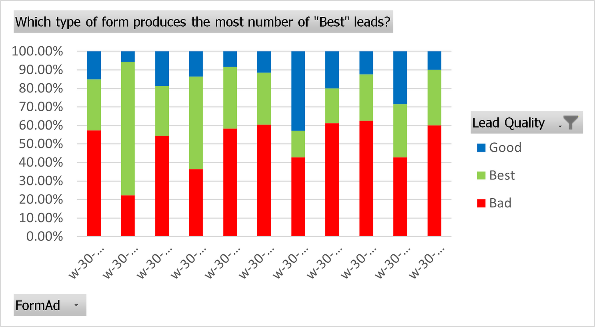
Chart 1
w-30-DebtReduction1-1DC-BlueMeter (a 1-page form with the BlueMeter design) has the highest number of “Best” leads.

Slide 4
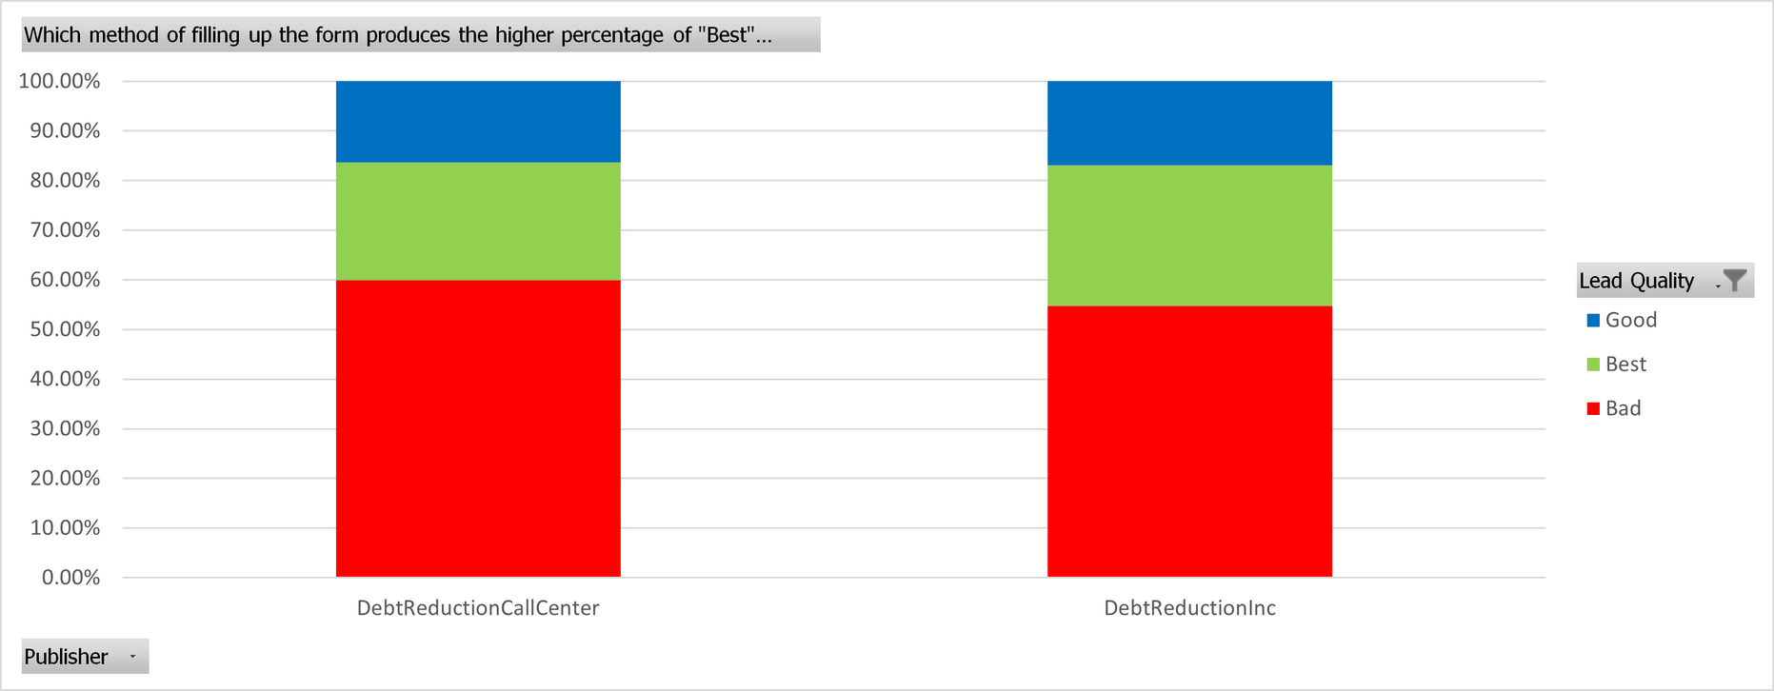
Chart 2
Having the form filled out by the lead itself produces the higher percentage of “Best” leads, but only by a small gap compared to when the lead contact the call center to fill out the form.

Slide 5
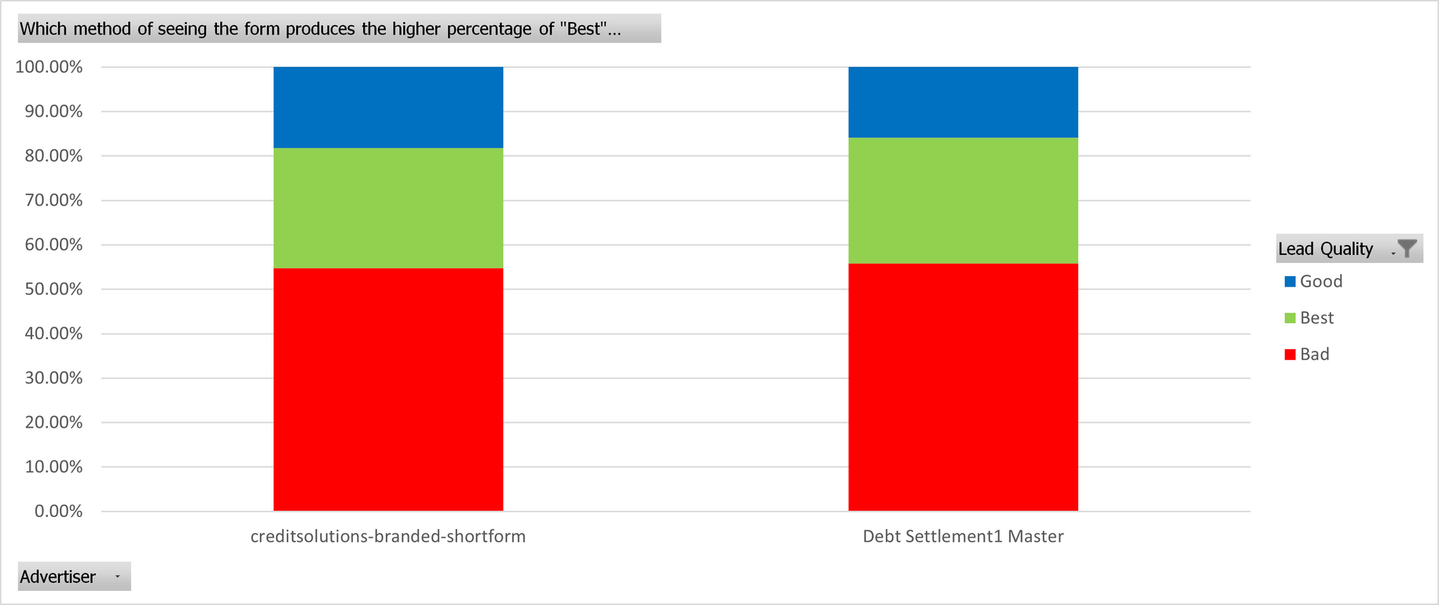
Chart 3
Seeing the generic form produces the higher percentage of “Best” leads, but only by a small gap compared to when the lead saw the form with the advertiser’s name on it.

Slide 6
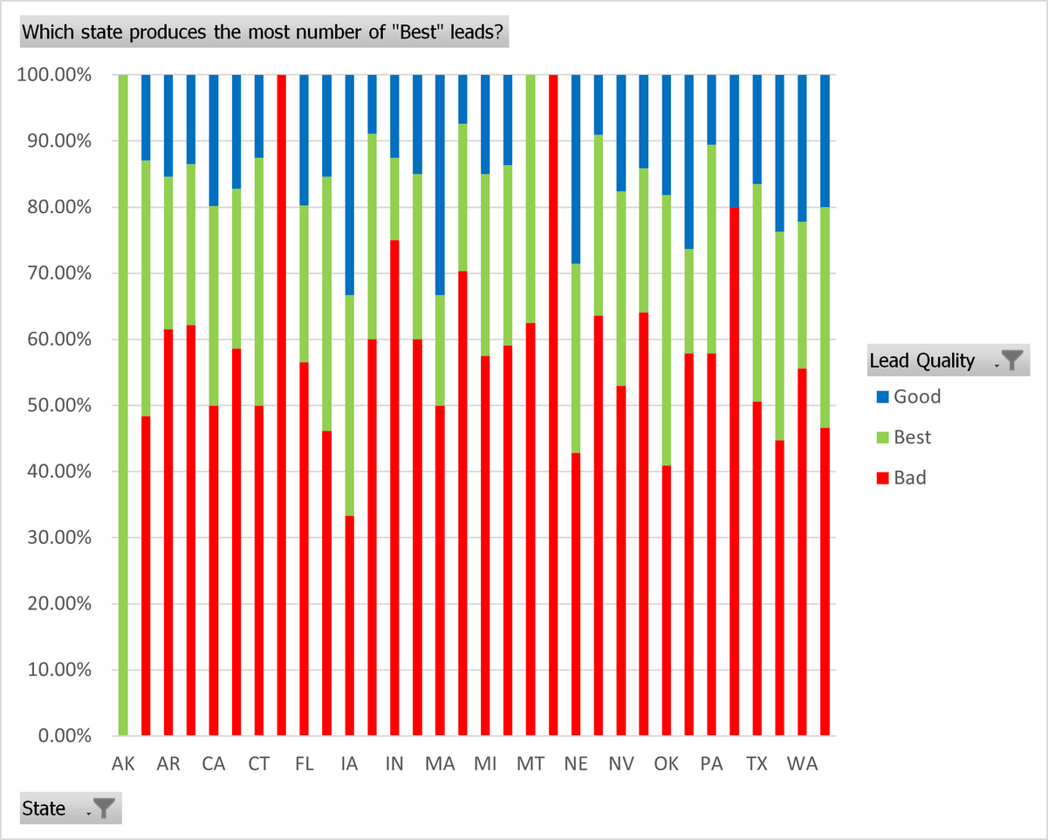
Chart 4
Alaska has the most number of “Best” leads, having all of their leads considered as “Best.”

Slide 7
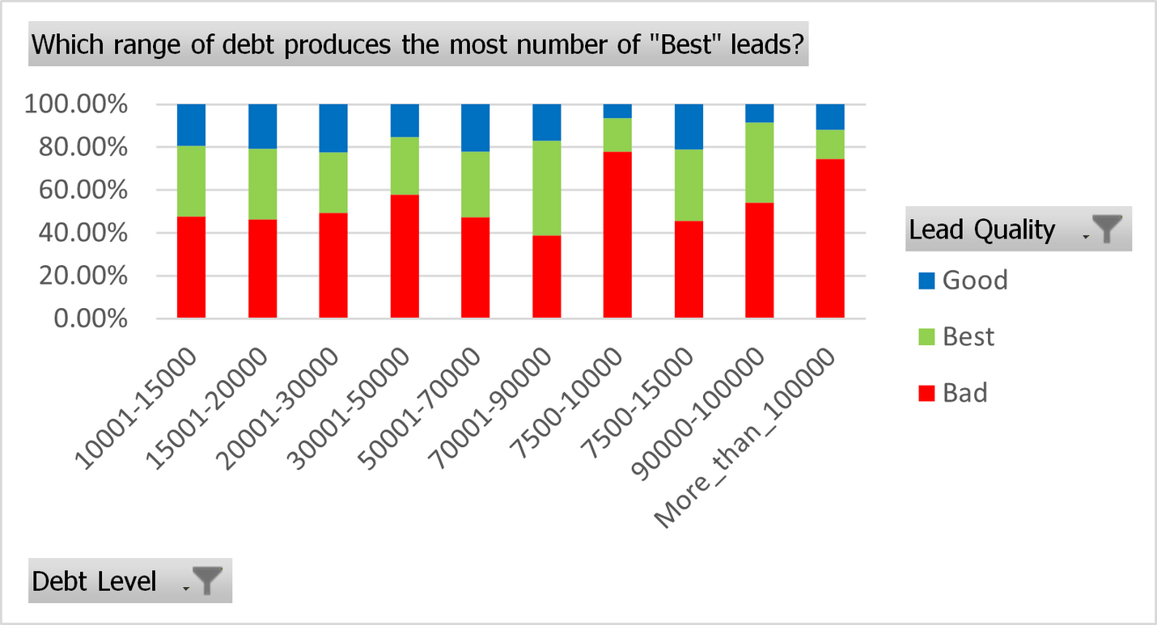
Chart 5
Leads with 70,001 to 90,000 debt level are most likely to be considered “Best” leads.

Slide 8
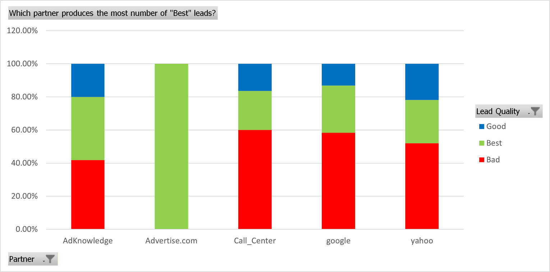
Chart 6
All leads who have seen the form through the partner company Advertise.com turned out to be “Best” leads.

Slide 9
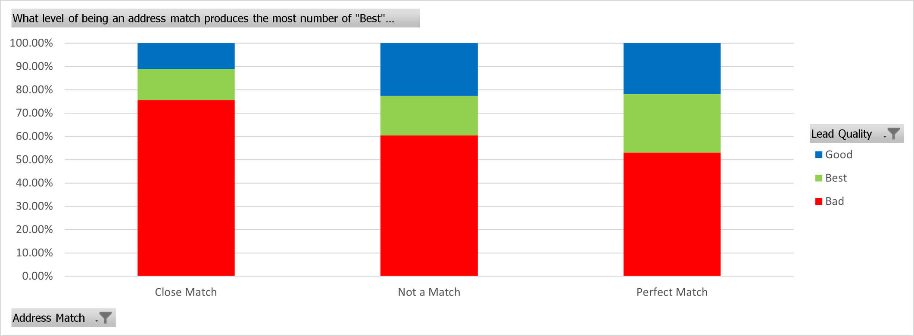
Chart 7
Leads who are considered a “Perfect Match” when it comes to their address and name are most likely to be the “Best” leads.

Slide 10
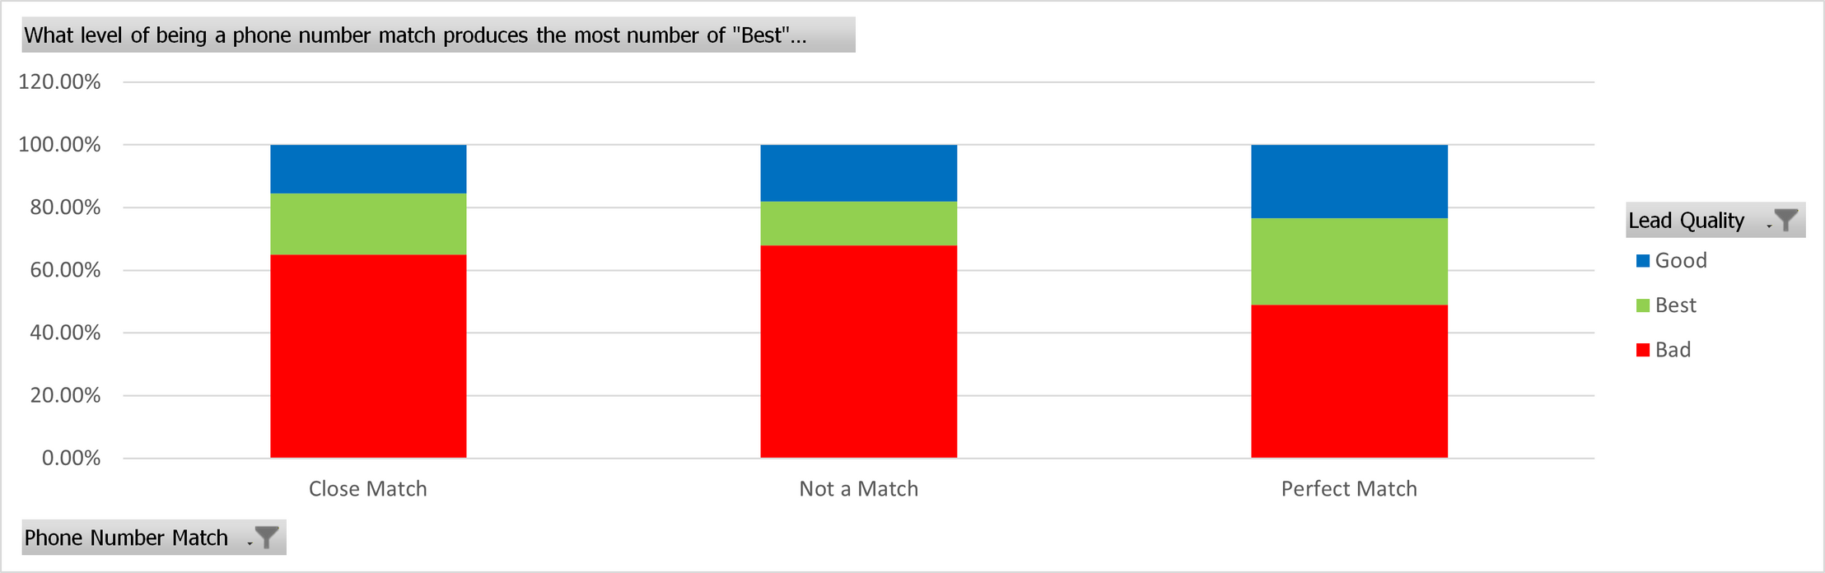
Chart 8
Leads who are considered a ‘Perfect Match” when it comes to their phone number and name are most likely to be the “Best” leads.

Slide 11
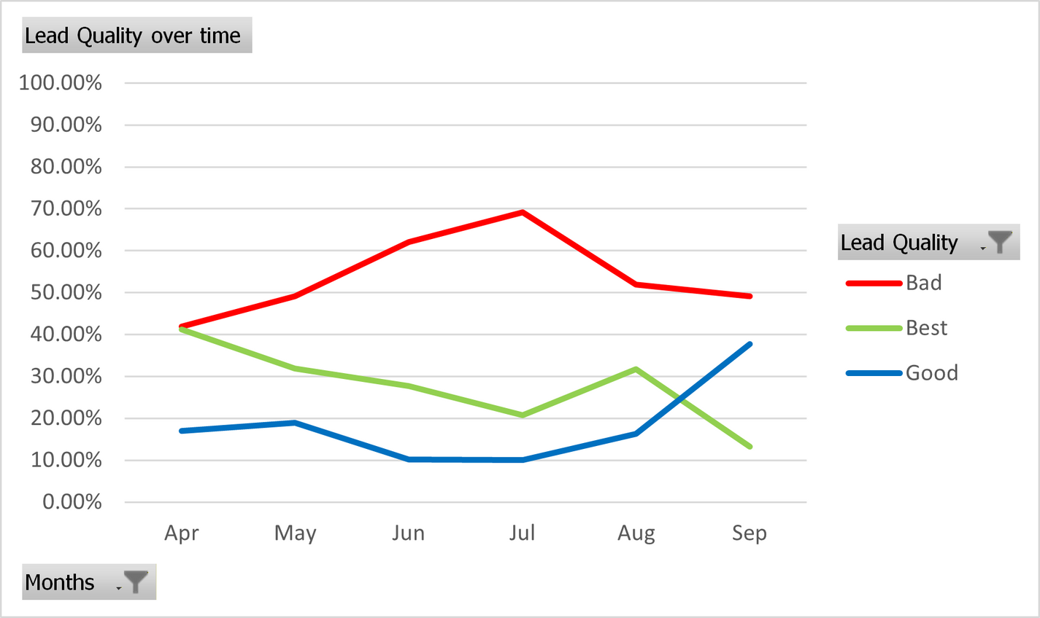
Chart 9
The “Best” leads are evidently decreasing over time. Improvements can be made to increase the “Best” leads.
The “Good” leads are increasing (improving) over time. A good statistic to keep up.
The “Bad” leads are increasing over time. While it decreased slightly, the upward movement is still evident. Improvements can be made as well to decrease the ‘Bad” leads.

Slide 12
Data Analyst Case Study
on lead quality
Gianina R. Ruidera

